Slide 1



Introduction to HashiCorp Vault
Presenting to: Opus Consulting Solutions
29-Feb-2024
Anand Kane

Slide 2


Agenda
Introduce the audience to the HashiCorp Vault and its usage in Spring Boot services
Use key value secrets to connect to PostgreSQL
Create short lived username and password dynamically to connect to PostgreSQL
Use Vault secrets in Spring Boot service
Takeaways from the session
Understand how sensitive information can be moved out of services and stored securely in HashiCorp Vault
Be able to create and manipulate static and dynamic secrets in Vault

Slide 3
HashiCorp Vault Introduction
Identity-based secrets and encryption management system
A secret is anything sensitive that needs to be secured, such as API encryption keys, passwords, and certificates
Secrets are encrypted before they are stored in the storage
Access to secrets is tightly controlled (restricted), and auditable
Clients (users, machines, apps) are authenticated and checked for authorization before they are given access to secrets
Allows configuration of fine-grained token-based access to various secrets by attaching tokens to policies
Secrets can be accessed via UI, CLI, and HTTP API
Notes:
Please use these blocks and resize as per your need . Do not alter colours and thickness

Slide 4
Basic Operations Using CLI
Starting Vault server
Enabling secrets
Creating secrets (put)
Updating secrets (patch)
Deleting secrets
Listing
Notes:
Please use these blocks and resize as per your need . Do not alter colours and thickness

Slide 5
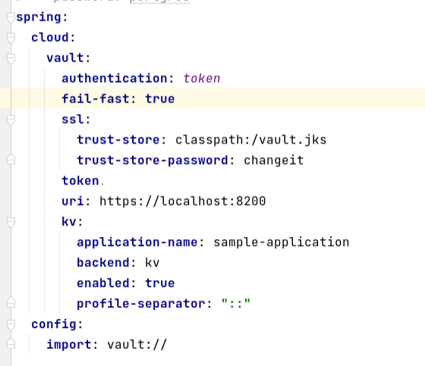
Integration with Spring Boot - Demo
Notes:
Please use these blocks and resize as per your need . Do not alter colours and thickness

Slide 6
HashiCorp Vault Key Features
Secure Secret Storage: Encrypts key/value secrets prior to writing them to persistent storage, so gaining access to the raw storage isn't enough to access your secrets.
Dynamic Secrets: Secrets can be generated dynamically for a given lease period (TTL). They are revoked automatically after the lease period is over. For example, credentials to access RDBMS DB, Message brokers, Kubernetes clusters etc.
Data Encryption: Vault can encrypt and decrypt data without storing it. This allows security teams to define encryption parameters and developers to encrypt data without having to design encryption methods.
Leasing and Renewal: All secrets in Vault have a lease associated with them. At the end of the lease, Vault will automatically revoke that secret. Clients can renew leases via built-in renew APIs.
Revocation: Vault has built-in support for secret revocation. Vault can revoke not only single secret, but a tree of secrets, for example all secrets read by a specific user, or all secrets of a particular type. Revocation assists in key rolling as well as locking down systems in the case of an intrusion.
Notes:
Please use these blocks and resize as per your need . Do not alter colours and thickness

Slide 7
Types of Secret Engines
Vault supports generation of credentials for most of the systems such as RDBMS, Message brokers, Cloud services, Kubernetes clusters etc.
It has a secret provider engine for every such system.
Vault provides plug-in interface to create engines for systems that are not supported out of the box
Some examples of secret provider engines are,
KV - generic secrets engine for storing key value secrets
Database - Generate username passwords to access most of the DBs dynamically.
RabbitMQ - Generate user credentials dynamically.
Kubernetes - Generate service account tokens dynamically.
Notes:
Please use these blocks and resize as per your need . Do not alter colours and thickness

Slide 8
Controlling access to secrets - Policies
Provides fine grain access to secrets
Allows configuring capabilities (read, write, delete, list etc.)
A token is attached to a policy when created
A token used to access secrets controls access and capabilities
Notes:
Please use these blocks and resize as per your need . Do not alter colours and thickness

Slide 9
Dynamic Secrets
Created on the fly when requested
No need to statically configure secrets in kv secrets
Not shared with other clients/services
No risk of being compromised
Have a configurable TTL and revocation mechanism
Vault provides support for most of common databases like PostgreSQL, Oracle, MySql etc
Vault allows creating plugins for data sources for which support is not provided out of the box
Notes:
Please use these blocks and resize as per your need . Do not alter colours and thickness

Slide 10
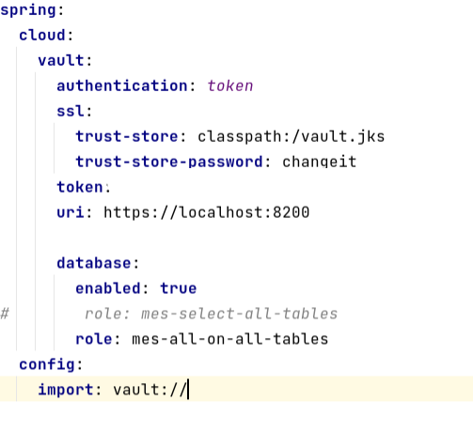
Dynamic secrets In Spring Boot - Demo
Notes:
Please use these blocks and resize as per your need . Do not alter colours and thickness

Slide 11



Q & A
Thank You.
2500 Northwinds Pkwy, Suite 630, Alpharetta 30009
@opusconsultingsolutions
https://www.opusconsulting.com/
@consultopus

